Slide 1

Data Science Committee
Session 2 - Introduction to Statistics for Data Science
Prepared by: Ashraf Abdulkhaliq

Slide 2
Outline
Intro to Statistics
Types of Data
Measure Data Quality using Statistics
Graphing Data (Visualization)
Important Notes

Slide 3
Outline
Intro to Statistics
Types of Data
Measure Data Quality using Statistics
Graphing Data (Visualization)
Important Notes

Slide 4
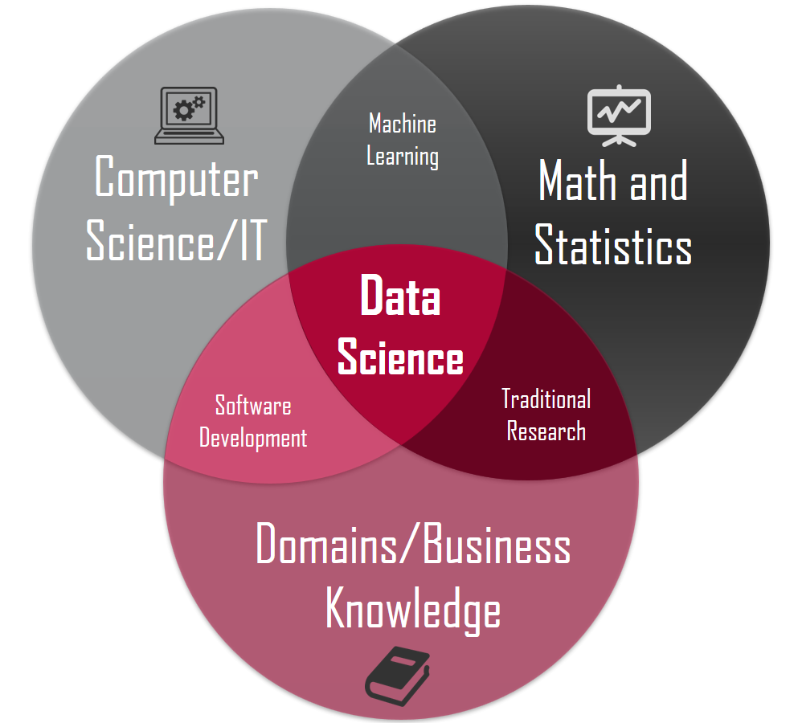
Intro to Statistics
Statistics is the study and manipulation of data, including ways to gather, review, analyze, and draw conclusions from data.
The two major areas of statistics are descriptive and inferential statistics.
Sampling techniques can be used to compile statistical data, including simple random, systematic, stratified, or cluster sampling.

Slide 5
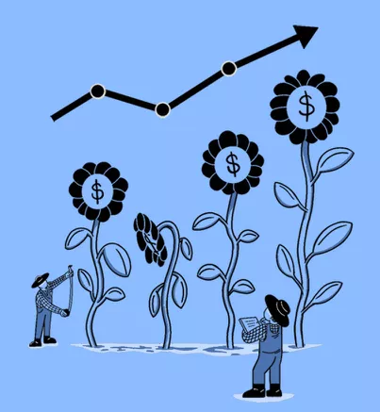
Importance of Statistics
Avoid getting biased samples
Prevent overgeneralization
Wrong causality
Incorrect Analysis

Slide 6
Outline
Intro to Statistics
Types of Data
Measure Data Quality using Statistics
Graphing Data (Visualization)
Important Notes

Slide 7
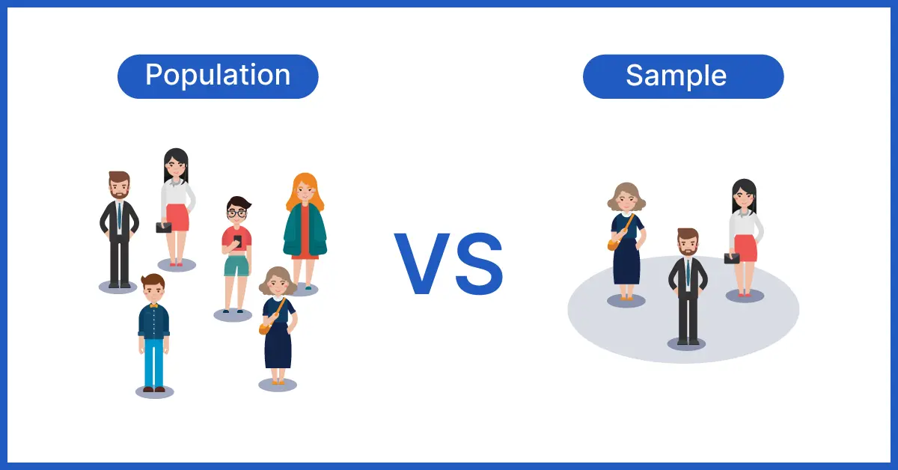

Slide 8
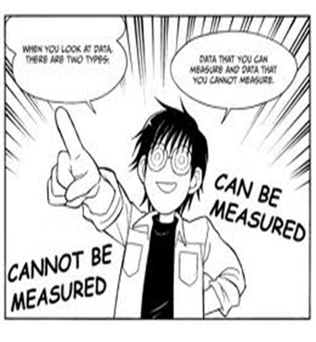
Types of Data
Knowledge
Information
Data
Data is the collection of facts

Slide 9
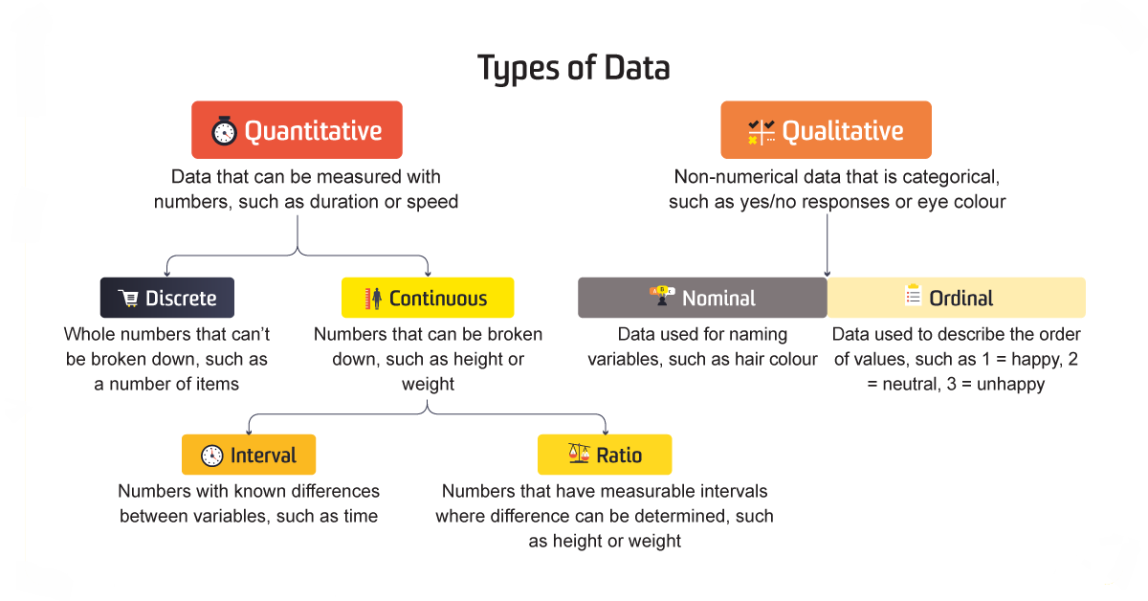

Slide 10
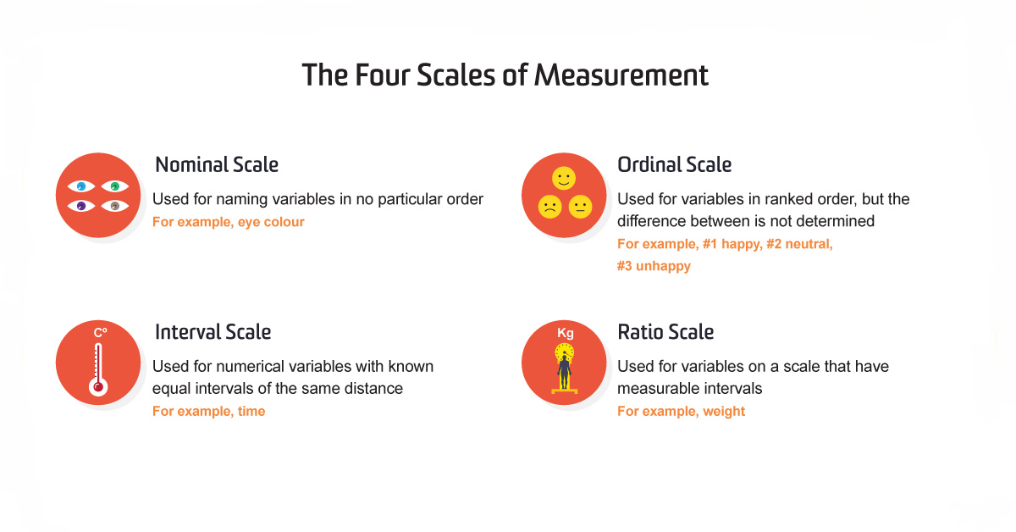

Slide 11
Types of Data (cont)
Qualitative Data
Quantitative Data
1. Nominal Data: Consists of categories or labels with no inherent order or ranking.
- Example:
Categories like blue, green, brown, and hazel represent nominal data.
Categories like apple, banana, orange, and grape are nominal data.
2. Ordinal Data: Categories with a natural order or ranking, but the differences between categories are not necessarily equal or well-defined.
- Example: Education Level: Categories like "high school," "bachelor's degree," "master's degree" represent ordinal data because they have a ranking but the difference in educational attainment between these categories is not uniform.
1. Continuous Data: Any value within a range and often involves measurements with infinite possibilities.
- Example:
Heights of individuals can vary within a continuous range, such as 162.5 cm, 173.2 cm, or 185.7 cm.
Temperature readings can have infinite decimal places, such as 23.5°C or 35.2°C.
2. Discrete Data: Discrete data consists of countable values that are typically whole numbers.
- Example:
Number of students in a classroom (e.g., 25, 30, 40) is a discrete.
Count of cars in a parking lot (e.g., 100, 150, 200) is discrete.

Slide 12
Outline
Intro to Statistics
Types of Data
Measure Data Quality using Statistics
Graphing Data (Visualization)
Important Notes

Slide 13
Measure Data Quality using Statistics
Descriptive Statistics
Inferential Statistics
Focus on summarizing and describing the properties of sample and population data.
Common tools:
Central tendency (mean, median, mode)
Variability (range, variance, …)
Data distribution
Skewness
Used to draw conclusions about a population based on data from a sample. They assess the reliability of these conclusions and are used for generalizing to larger groups or making predictions.
Common tools:
Hypothesis testing
Regression Analysis

Slide 14
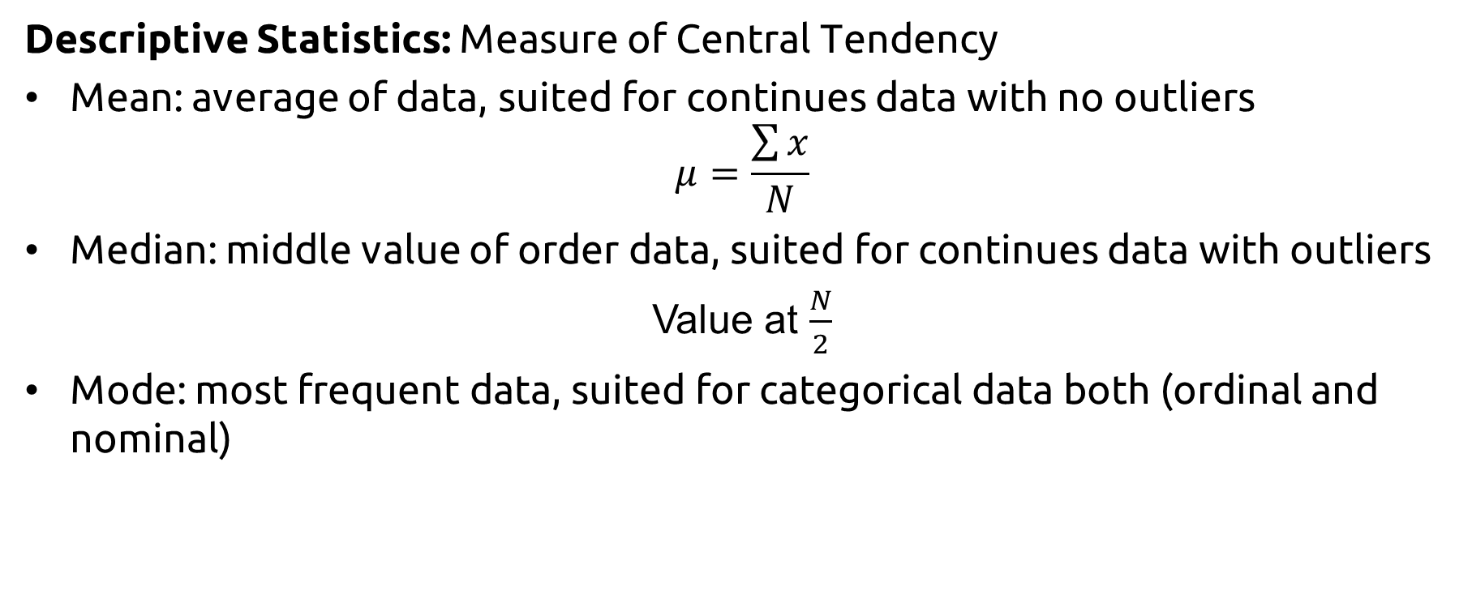
Measure Data Quality (cont)
Descriptive Statistics: Measure of Central Tendency
Mean: average of data, suited for continues data with no outliers
$$μ=\frac{\sum{x}}{N}$$
Median: middle value of order data, suited for continues data with outliers
Value at $\frac{N}{2}$
Mode: most frequent data, suited for categorical data both (ordinal and nominal)

Slide 15
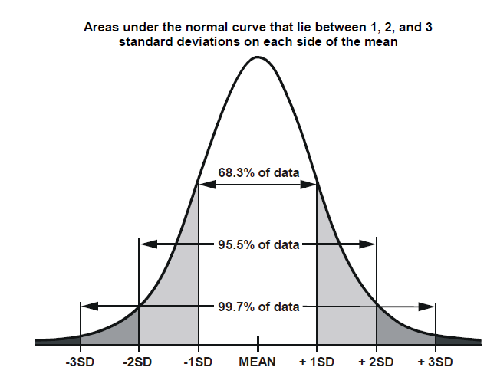

Measure Data Quality (cont)
Descriptive Statistics: Measure of Variance
Range = Max - Min
Interquartile Range = Q3 – Q1
Variance $σ^{2}= \frac{\sum{{(x − μ)}^{2}}}{N−1}$
Standard Deviation $σ= \sqrt{σ^{2}}$

Slide 16
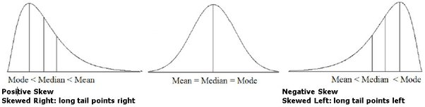
Measure Data Quality (cont)
Descriptive Statistics: Skewness

Slide 17
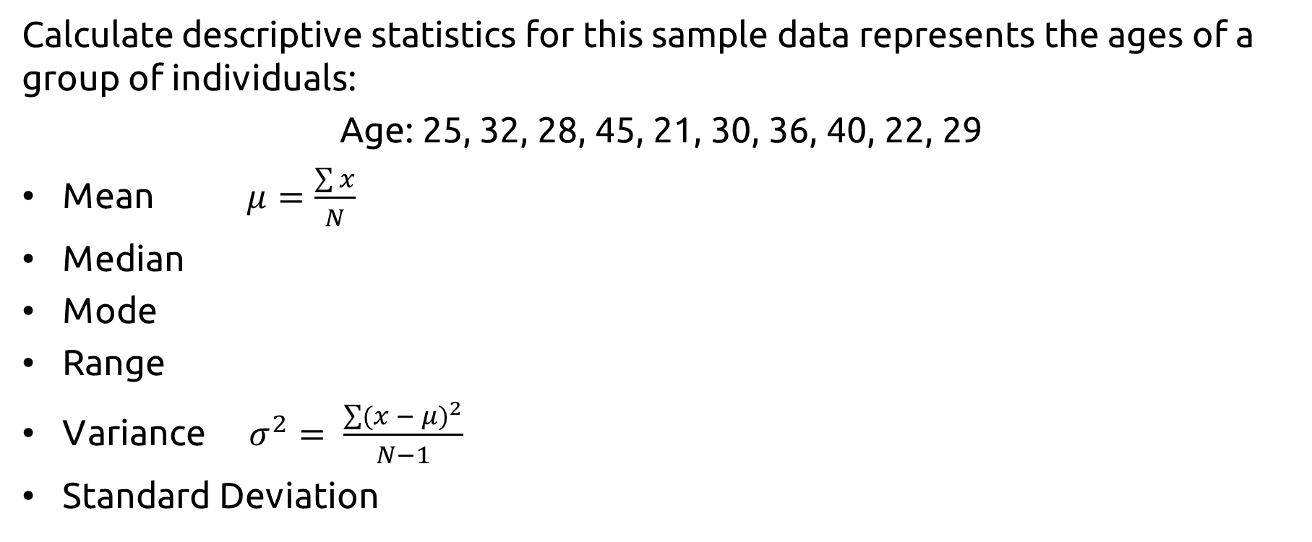
Exercise
Calculate descriptive statistics for this sample data represents the ages of a group of individuals:
Age: 25, 32, 28, 45, 21, 30, 36, 40, 22, 29
Mean $μ=\frac{\sum{x}}{N}$
Median
Mode
Range
Variance $σ^{2}= \frac{\sum{{(x − μ)}^{2}}}{N−1}$
Standard Deviation

Slide 18
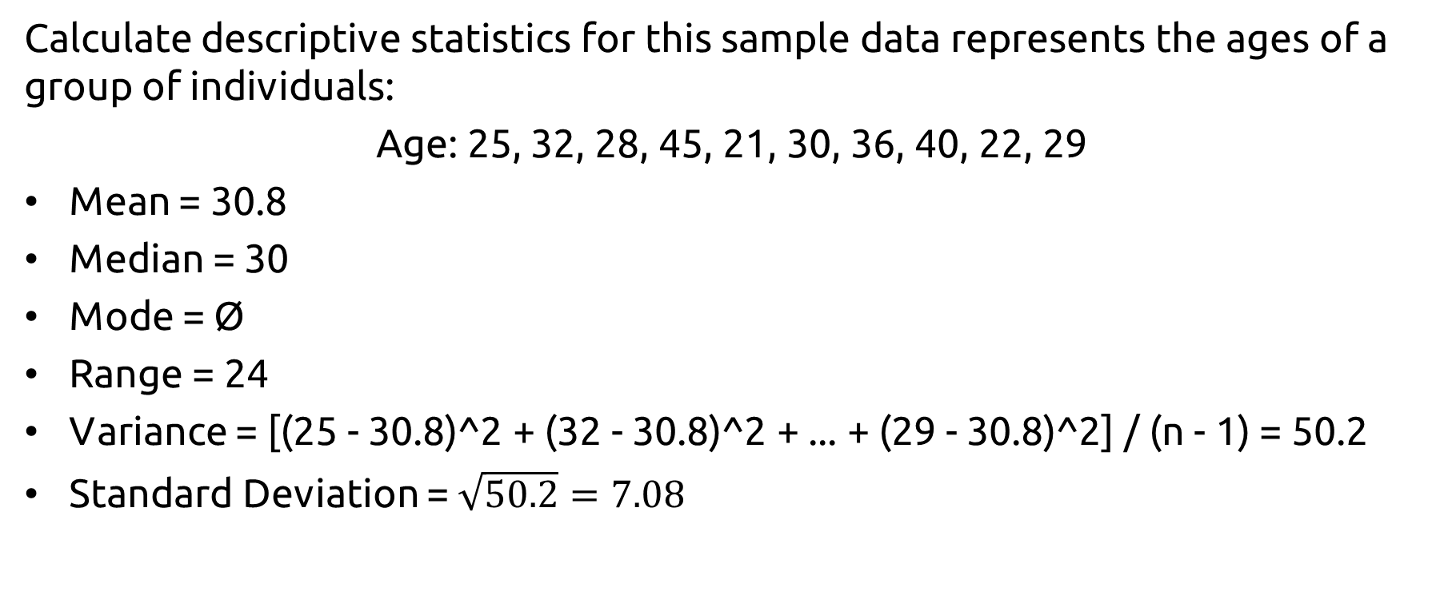
Exercise (solved)
Calculate descriptive statistics for this sample data represents the ages of a group of individuals:
Age: 25, 32, 28, 45, 21, 30, 36, 40, 22, 29
Mean = 30.8
Median = 30
Mode = Ø
Range = 24
Variance = [(25 - 30.8)^2 + (32 - 30.8)^2 + ... + (29 - 30.8)^2] / (n - 1) = 50.2
Standard Deviation = $\sqrt{50.2}=7.08$

Slide 19
Outline
Intro to Statistics
Types of Data
Measure Data Quality using Statistics
Graphing Data (Visualization)
Important Notes

Slide 20
Goal of Graphing data
Presentation of Descriptive Statistics.
Presentation of Evidence.
Some people understand subject matter better with visual aids.
Provide a sense of the underlying data generating process (scatter-plots).

Slide 21
Graphing Data (Visualization)
Bar chart: used to compare two or more values in a category and how multiple pieces of data relate to each other.
Line chart: is used to visually represent trends, patterns and fluctuations in the data set. Line charts are commonly used to forecast information.
Scatter plot: is used to show the relationship (correlation) between data points in a compact visual form.
Box plot: provides a visual summary of the central tendency, variability, and skewness of the data.
Pie chart: is used to compare the parts of a whole.
Funnel chart: is used to represent how data moves through different steps or stages in a process.
Histogram: is used to represent data over a certain time or interval.

Slide 22
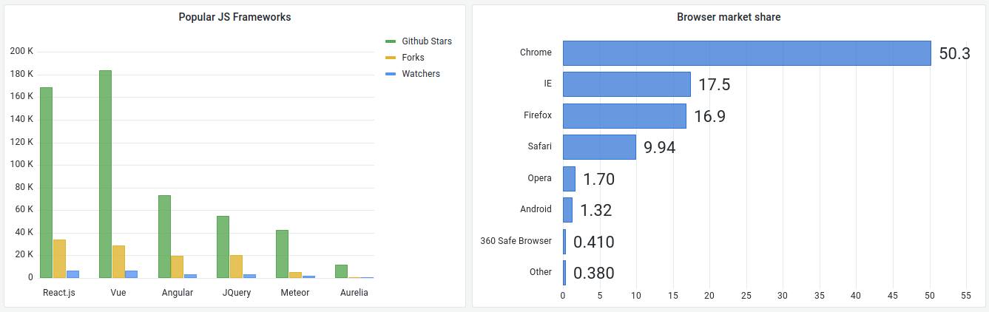
Graphing Data (cont)
Bar chart: used to compare two or more values in a category and how multiple pieces of data relate to each other.

Slide 23
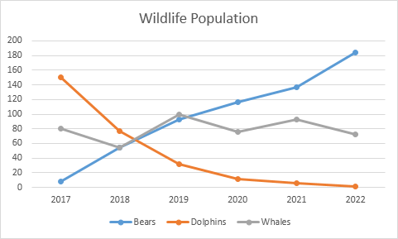
Graphing Data (cont)
Line chart: is used to visually represent trends, patterns and fluctuations in the data set. Line charts are commonly used to forecast information.

Slide 24
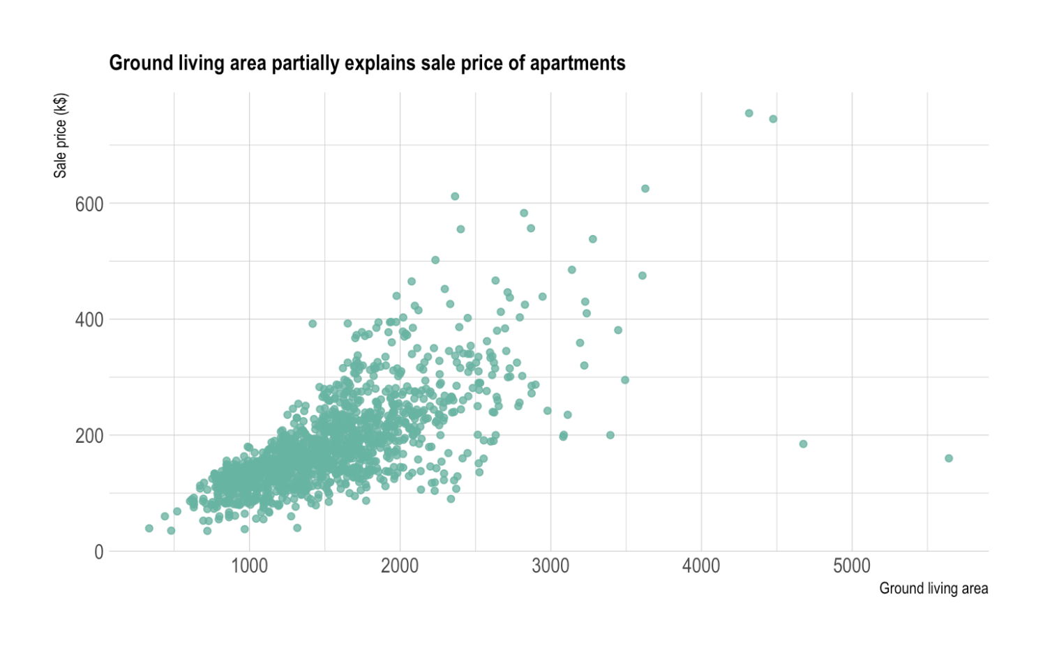
Graphing Data (cont)
Scatter plot: is used to show the relationship (correlation) between data points in a compact visual form.

Slide 25
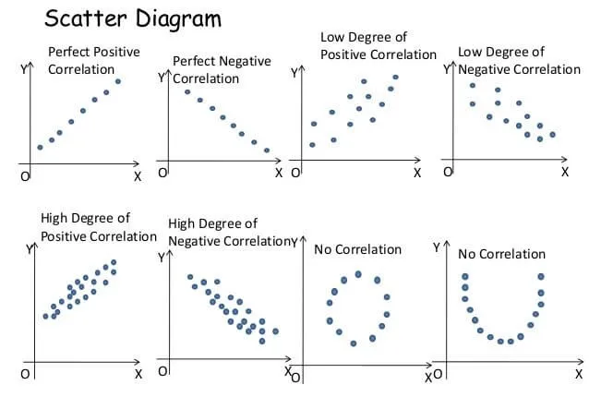
Graphing Data (cont)
Scatter plot: is used to show the relationship (correlation) between data points in a compact visual form.

Slide 26
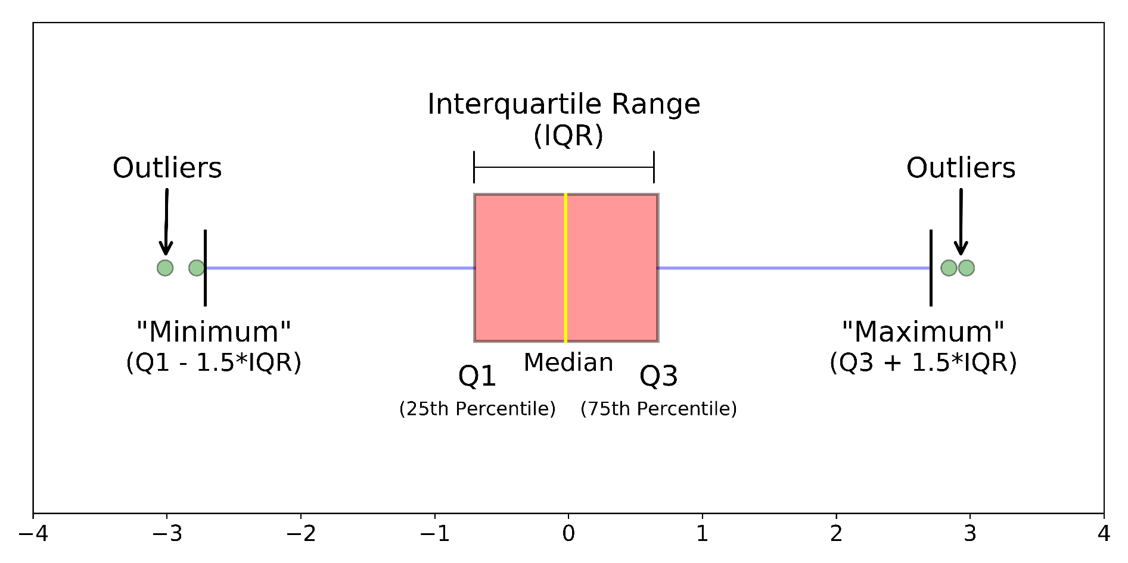
Graphing Data (cont)
Box plot: provides a visual summary of the central tendency, variability, and skewness of the data.

Slide 27
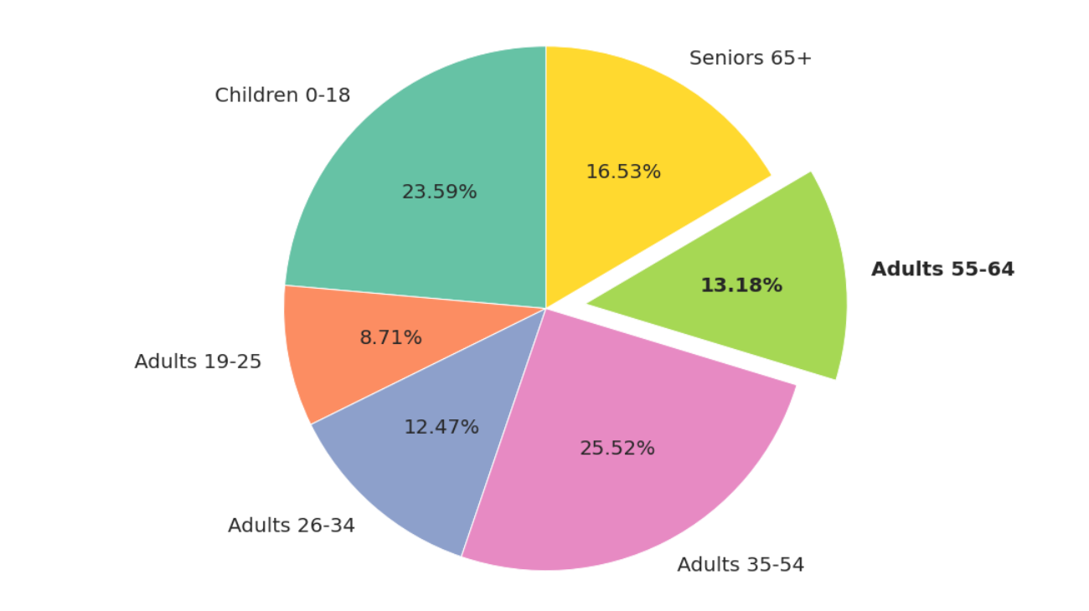
Graphing Data (cont)
Pie chart: is used to compare the parts of a whole.

Slide 28
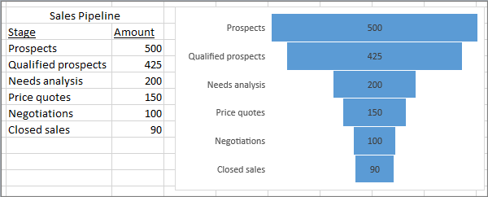
Graphing Data (cont)
Funnel chart: is used to represent how data moves through different steps or stages in a process.

Slide 29
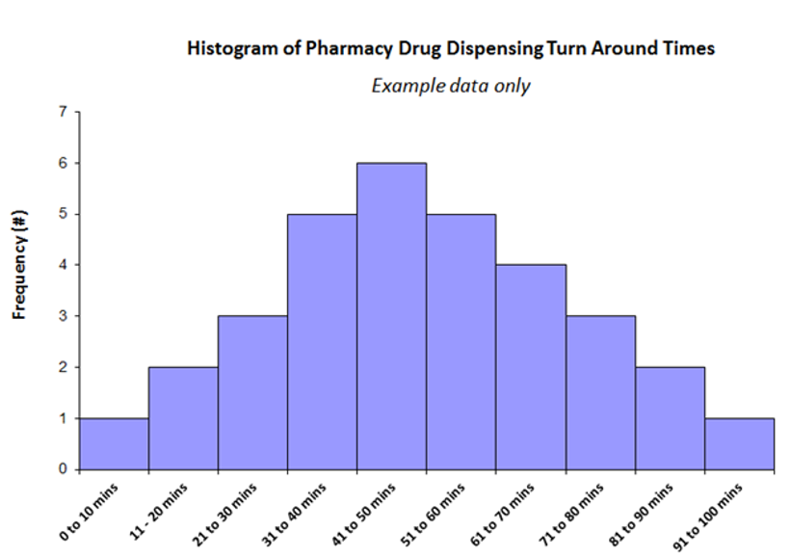
Graphing Data (cont)
Histogram: is used to represent data over a certain time or interval.

Slide 30
Outline
Intro to Statistics
Types of Data
Measure Data Quality using Statistics
Graphing Data (Visualization)
Important Notes

Slide 31
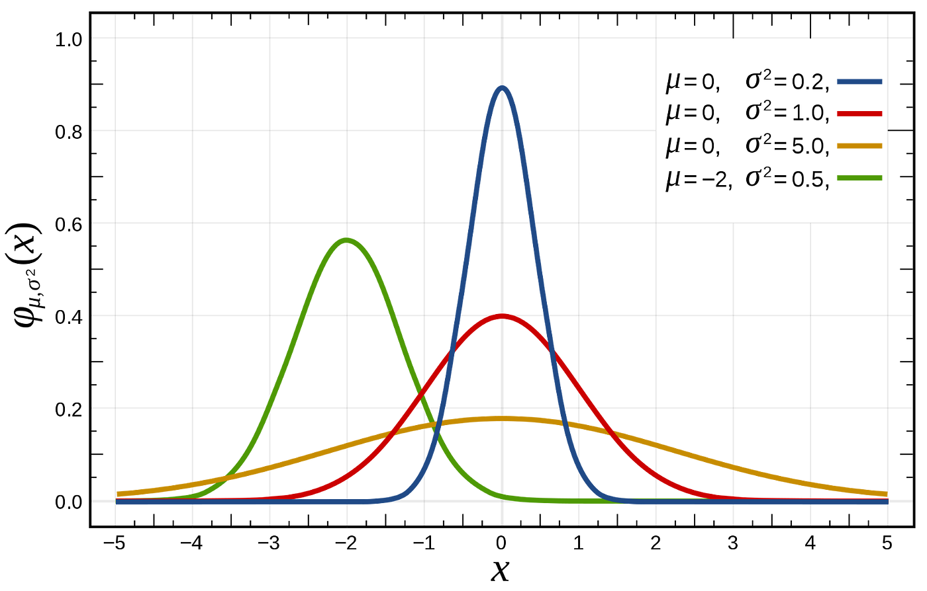
Important Notes
How does changing the standard deviation and the mean affect the normal distribution?

Slide 32
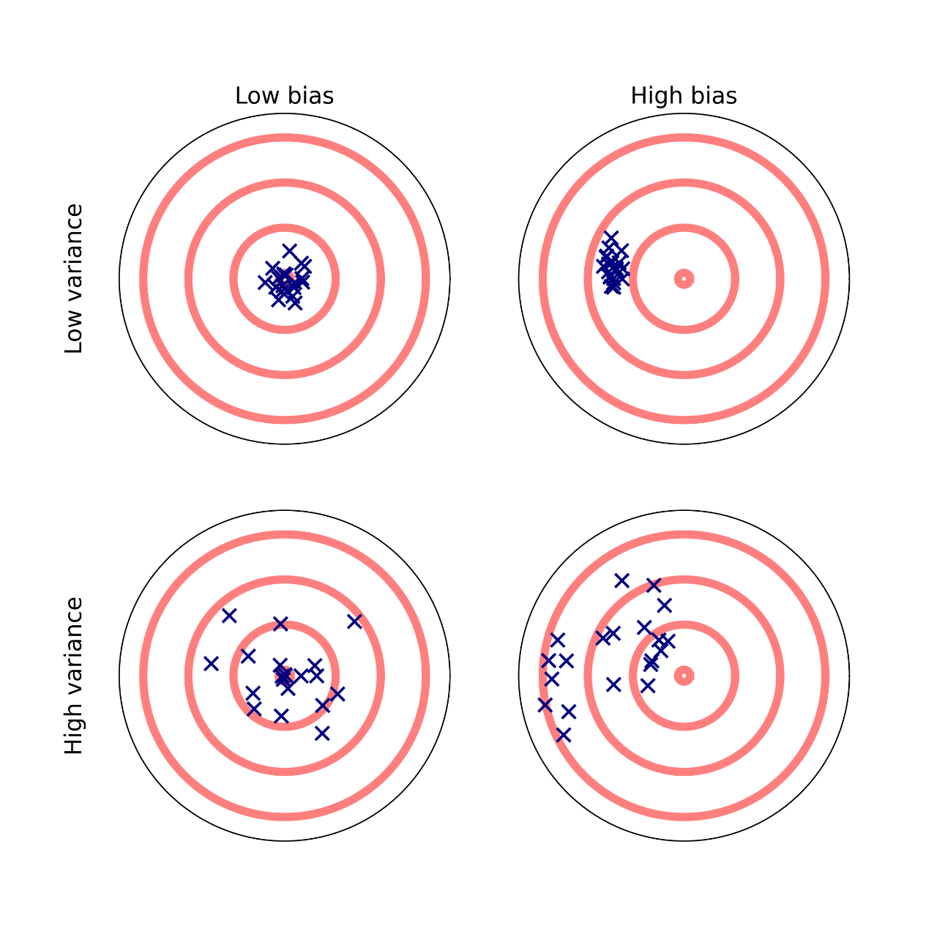
Important Notes (cont)
Variance vs Bias

Slide 33
References
https://www.investopedia.com/terms/s/statistics.asp
https://www.voxco.com/blog/population-vs-sample/
https://studyonline.unsw.edu.au/blog/types-of-data
https://www.quora.com/How-do-you-interpret-skewness-in-a-histogram
https://mathbitsnotebook.com/Algebra1/StatisticsData/STShapes.html

Slide 34
Thanks
Please keep updated:
https://github.com/kershrita/IEEE-Data-Science

